Slide 1
WELCOME

Slide 2
WELCOME

Slide 3
WELCOME

Slide 4
TEAM
WELCOME
CRYPTIC CODEX

Slide 5












CRYPTIC CODEX
Fahim
Audhira
Lutful
Jannat
Samia
samia_672
SAMIA ZAMAN
samia.zaman.251@northsouth.edu
samiazaman56

Slide 6
Text-Based Adventure
C Programming Odyssey
Embark on a journey through code. Discover the creation of a text-based adventure game. Explore the methodology, challenges, and future of this C programming project.

Slide 7
Shadows of the forsaken

Slide 8
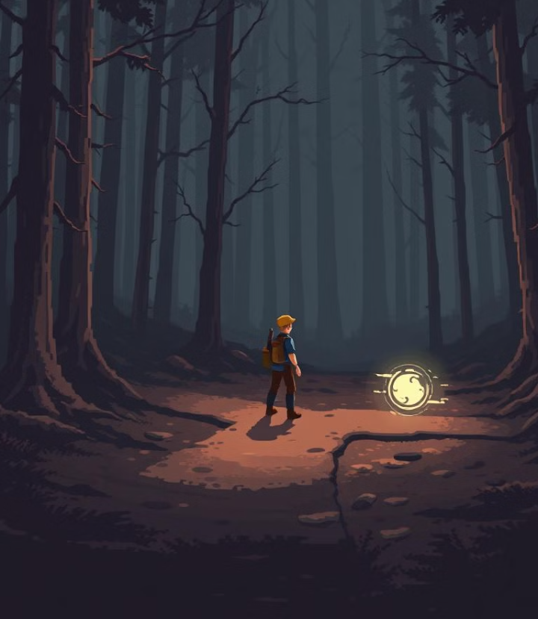
Shadows of the forsaken
INTERACTIVE NARATIVE
Engage in a branching storyline.
Make choices that shape your adventure.
C PROGRAMMING CORE
Built entirely in C. Optimized for performance and resource management.

Slide 9
Shadows of the forsaken
INTERACTIVE NARATIVE
Engage in a branching storyline.
Make choices that shape your adventure.
C PROGRAMMING CORE
Built entirely in C. Optimized for performance and resource management.
RETRO AESTHETICS
Classic text-based interface. Evokes nostalgia for early computer games

Slide 10
Immersive Story
Player Agency
Your decisions matter. Multiple endings based on your choices.
Shadows of the forsaken
C PROGRAMMING CORE
Built entirely in C. Optimized for performance and resource management.
RETRO AESTHETICS
Classic text-based interface. Evokes nostalgia for early computer games
IMMERSIVE STORY
A rich, detailed world. Uncover secrets and face challenging quests.

Slide 11
Immersive Story
Player Agency
Your decisions matter. Multiple endings based on your choices.
Shadows of the forsaken
C PROGRAMMING CORE
Built entirely in C. Optimized for performance and resource management.
IMMERSIVE STORY
A rich, detailed world. Uncover secrets and face challenging quests.
PLAYER AGENCY
Your decisions matter. Multiple endings based on your choices.
RETRO AESTHETICS
Classic text-based interface. Evokes nostalgia for early computer games

Slide 12
Immersive Story
Player Agency
Your decisions matter. Multiple endings based on your choices.
Shadows of the forsaken
C PROGRAMMING CORE
Built entirely in C. Optimized for performance and resource management.
IMMERSIVE STORY
A rich, detailed world. Uncover secrets and face challenging quests.
PLAYER AGENCY
Your decisions matter. Multiple endings based on your choices.
RETRO AESTHETICS
Classic text-based interface. Evokes nostalgia for early computer games

Slide 13




FROM CONCPET TO CODE
IDEA
DESIGN
DEBUGGING
CODE

Slide 14
CRYPTIC CODEX
Fahim
Audhira
Lutful
Jannat
Samia
samia_672
SAMIA ZAMAN
samia.zaman.251@northsouth.edu
samiazaman56

Slide 15


CRYPTIC CODEX
Fahim
Siam
Lutful
Jannat
Audhira
sunnah_75
AUDHIRA MUNTAHA
Audhira.muntaha.251@northsouth.edu
audhira251

Slide 16

DISCOVER
SHADOWS OF THE FORSAKEN

Slide 17
DISCOVER
SHADOWS OF THE FORSAKEN

Slide 18
DISCOVER
SHADOWS OF THE FORSAKEN

Slide 19
UNRAVELING MYSTERY

Slide 20
UNRAVELING MYSTERY

Slide 21
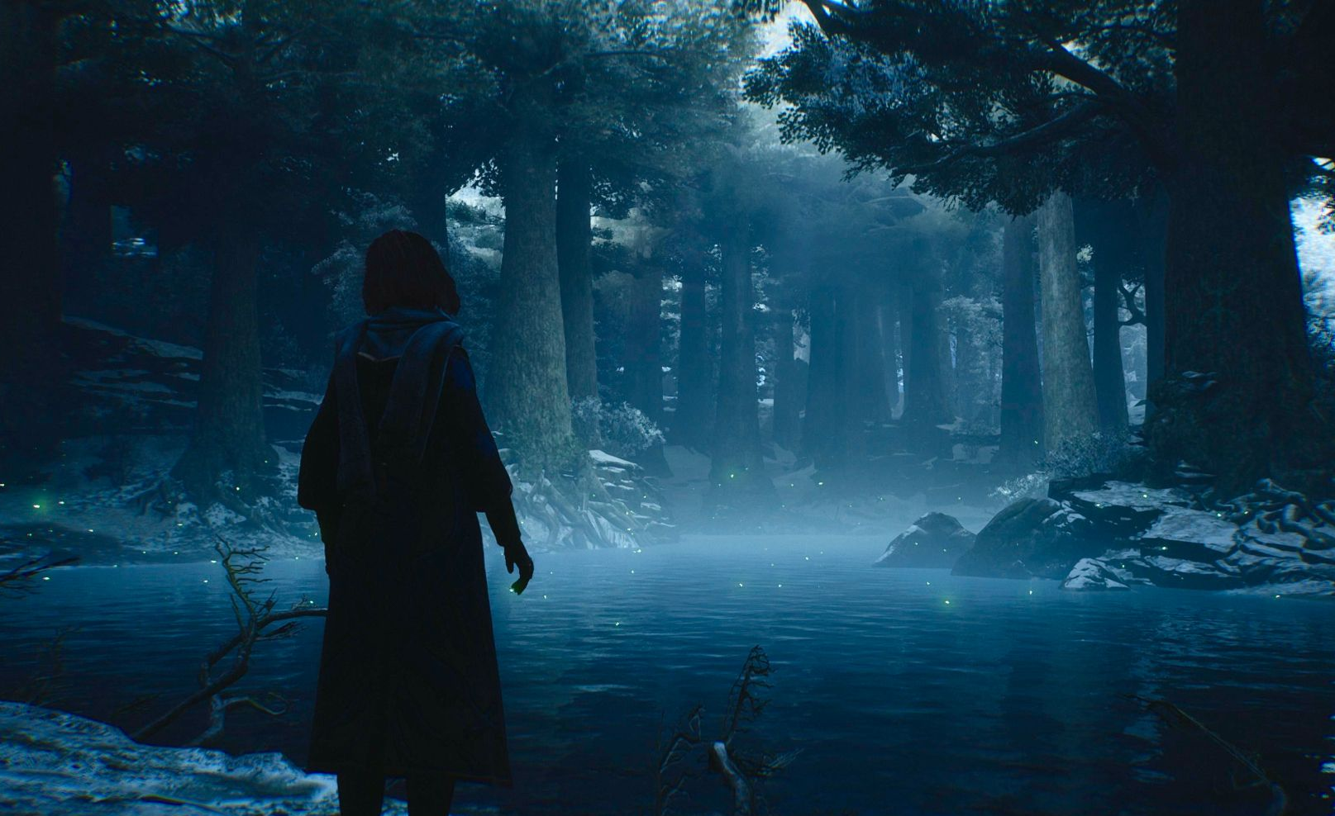

Slide 22


Slide 23

RIDDLE !!!!!

Slide 24

Will they escape, or will the forest claim them forever?

Slide 25
CRYPTIC CODEX
Fahim
Siam
Lutful
Jannat
Audhira
sunnah_75
AUDHIRA MUNTAHA
sidratul.audhira.251@northsouth.edu
audhira251

Slide 26


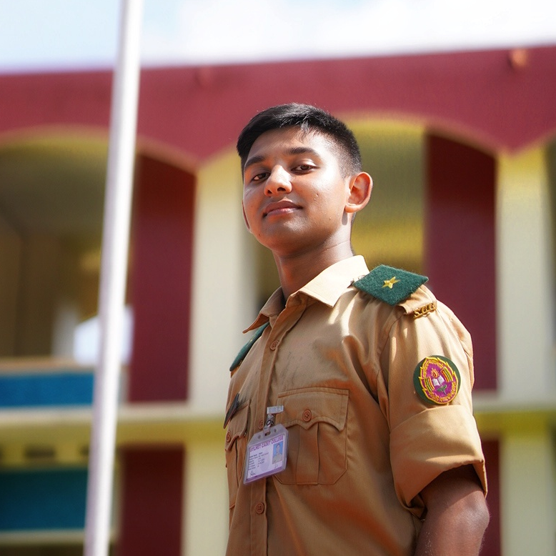
CRYPTIC CODEX
Samia
Audhira
Lutful
Jannat
Fahim
sterben.86
MD. FAHIM HOSSAIN
fahim.hossain.251@northsouth.edu
FahimHossain2186

Slide 27
UNRAVELING MYSTERY

Slide 28
FROM HELLO WORLD
TO ADVENTURE
Game structure design was confusing initially
Managing multiple choices and paths in code
!!
!!
!!
Difficulty in imagining the mansion layout visually

Slide 29
FROM HELLO WORLD
TO ADVENTURE
Game structure design was confusing initially
Managing multiple choices and paths in code
!!
!!
!!
Difficulty in imagining the mansion layout visually

Slide 30
FROM HELLO WORLD
TO ADVENTURE
Managing multiple choices and paths in code
!!
!!
!!
We created a flowchart to plan each scene and connection clearly.
Difficulty in imagining the mansion layout visually

Slide 31
FROM HELLO WORLD
TO ADVENTURE
!!
!!
!!
We created a flowchart to plan each scene and connection clearly.
Used switch, if statements and functions to handle different scenarios.
Difficulty in imagining the mansion layout visually

Slide 32
FROM HELLO WORLD
TO ADVENTURE
!!
!!
!!
We created a flowchart to plan each scene and connection clearly.
Used switch, if statements and functions to handle different scenarios.
Designed a ASCII map to visualize the mansion

Slide 33
FROM HELLO WORLD
TO ADVENTURE
!!
!!
!!
!!
!!
??
We created a flowchart to plan each scene and connection clearly.
Used switch, if statements and functions to handle different scenarios.
Designed a ASCII map to visualize the mansion
User Making Invalid Choices
Input Buffer
Esc Key

Slide 34
FROM HELLO WORLD
TO ADVENTURE
!!
!!
!!
!!
!!
??
We created a flowchart to plan each scene and connection clearly.
Used switch, if statements and functions to handle different scenarios.
Designed a ASCII map to visualize the mansion
User Making Invalid Choices
Input Buffer
Esc Key

Slide 35
FROM HELLO WORLD
TO ADVENTURE
!!
!!
!!
!!
!!
??
We created a flowchart to plan each scene and connection clearly.
Used switch, if statements and functions to handle different scenarios.
Designed a ASCII map to visualize the mansion
get_choice() handles invalid inputs and prompts the user again until a valid choice is entered.
Input Buffer
Esc Key

Slide 36
FROM HELLO WORLD
TO ADVENTURE
!!
!!
!!
!!
!!
??
We created a flowchart to plan each scene and connection clearly.
Used switch, if statements and functions to handle different scenarios.
Designed a ASCII map to visualize the mansion
get_choice() handles invalid inputs and prompts the user again until a valid choice is entered.
Using getch() allows for real-time key detection
Esc Key

Slide 37
FROM HELLO WORLD
TO ADVENTURE
!!
!!
!!
!!
!!
??
We created a flowchart to plan each scene and connection clearly.
Used switch, if statements and functions to handle different scenarios.
Designed a ASCII map to visualize the mansion
get_choice() handles invalid inputs and prompts the user again until a valid choice is entered.
Using getch() allows for real-time key detection
In get_choice(), pressing ESC (ASCII 27) returns to the pop up menu

Slide 38
FROM HELLO WORLD
TO ADVENTURE
!!
!!
!!
!!
!!
??
!!
!!
!!
We created a flowchart to plan each scene and connection clearly.
Used switch, if statements and functions to handle different scenarios.
Designed a ASCII map to visualize the mansion
get_choice() handles invalid inputs and prompts the user again until a valid choice is entered.
Using getch() allows for real-time key detection
In get_choice(), pressing ESC (ASCII 27) returns to the pop up menu
Save to Current CheckPoint
Resume from Last Saved Scene
Saved Scene to Real Game

Slide 39
FROM HELLO WORLD
TO ADVENTURE
!!
!!
!!
!!
??
!!
!!
!!
!!
get_choice() handles invalid inputs and prompts the user again until a valid choice is entered.
Used switch, if statements and functions to handle different scenarios.
Designed a ASCII map to visualize the mansion
We created a flowchart to plan each scene and connection clearly.
Using getch() allows for real-time key detection
In get_choice(), pressing ESC (ASCII 27) returns to the pop up menu
Save to Current CheckPoint
Resume from Last Saved Scene
Saved Scene to Real Game

Slide 40
FROM HELLO WORLD
TO ADVENTURE
!!
!!
!!
!!
??
!!
!!
!!
!!
get_choice() handles invalid inputs and prompts the user again until a valid choice is entered.
Used switch, if statements and functions to handle different scenarios.
Designed a ASCII map to visualize the mansion
We created a flowchart to plan each scene and connection clearly.
Using getch() allows for real-time key detection
In get_choice(), pressing ESC (ASCII 27) returns to the pop up menu
save() writes the current sceneNo into a file (load.txt) and confirms the save.
Resume from Last Saved Scene
Saved Scene to Real Game

Slide 41
FROM HELLO WORLD
TO ADVENTURE
!!
!!
!!
!!
??
!!
!!
!!
!!
get_choice() handles invalid inputs and prompts the user again until a valid choice is entered.
Used switch, if statements and functions to handle different scenarios.
Designed a ASCII map to visualize the mansion
We created a flowchart to plan each scene and connection clearly.
Using getch() allows for real-time key detection
In get_choice(), pressing ESC (ASCII 27) returns to the pop up menu
save() writes the current sceneNo into a file (load.txt) and confirms the save.
load() reads the saved scene number from load.txt & calls saveVault(sceneNo)
Saved Scene to Real Game

Slide 42
FROM HELLO WORLD
TO ADVENTURE
!!
!!
!!
!!
??
!!
!!
!!
!!
get_choice() handles invalid inputs and prompts the user again until a valid choice is entered.
Used switch, if statements and functions to handle different scenarios.
Designed a ASCII map to visualize the mansion
We created a flowchart to plan each scene and connection clearly.
Using getch() allows for real-time key detection
In get_choice(), pressing ESC (ASCII 27) returns to the pop up menu
save() writes the current sceneNo into a file (load.txt) and confirms the save.
load() reads the saved scene number from load.txt & calls saveVault(sceneNo)
a switch-case structure to map the saved scene number (sceneNo) to a specific function

Slide 43


CRYPTIC CODEX
Samia
Audhira
Lutful
Jannat
Fahim
sterben.86
MD. FAHIM HOSSAIN
fahim.hossain.251@northsouth.edu
FahimHossain2186

Slide 44



CRYPTIC CODEX
Fahim
Audhira
Lutful
Jannat
Lutful-alam-36300
MD. LUTFUL ALAM
lutful.alam.241@northsouth.edu
Lutful-alam

Slide 45
FROM HELLO WORLD
TO ADVENTURE

Slide 46
GAME FLOW

Slide 47
ENTER THE MANSION
Forest
journey
STAY OUTSIDE
GAME FLOW
! KNOCK !
!! KNOCK !!

Slide 48
ENTER THE MANSION
GAME FLOW

Slide 49
SOUND !!
IGNORE
NOISE ??
INVESTIGATE
ENTER THE MANSION
Abandoned mansion
BREAK THE WINDOW
GAME FLOW
SPLIT UP AND SEARCH
Forest
journey
STAY OUTSIDE
! KNOCK !
!! KNOCK !!

Slide 50
NOISE ??
INVESTIGATE
GAME FLOW

Slide 51
PUTTING THE PAINTING OFF
NOISE ??
INVESTIGATE
VANISHING PORTRAITS
KNOCK !!
WHO IS THERE!
GAME FLOW
EXAMINE THE
PAINTING
Forest
journey
STAY OUTSIDE
! KNOCK !
!! KNOCK !!

Slide 52
KNOCK !!
WHO IS THERE!
Game over
GAME FLOW

Slide 53
GAME FLOW

Slide 54
UPCOMING UPGRADES

Slide 55
UPCOMING UPGRADES
RANDOM
EVENTS
MULTIPLE
ENDINGS
SAVE
& LOAD
03
04
02
INVENTORY
PLAYER PROFILE
05
01
GUI
06

Slide 56
UPCOMING UPGRADES
RANDOM
EVENTS
MULTIPLE
ENDINGS
SAVE
& LOAD
03
04
02
INVENTORY
PLAYER PROFILE
05
01
GUI
06

Slide 57
UPCOMING UPGRADES

Slide 58

THE JOURNEY ENDS
ANY QUESTIONS ??

Slide 59


Slide 60
EXAMINE THE
PAINTING
GAME FLOW

Slide 61
CLOSE THE BOOK
EXAMINE THE
PAINTING
WISHPERING
BOOKSHELF
BURN THE BOOKSHELF
GAME FLOW
PULL THE WHISPERING BOOK
Forest
journey
STAY OUTSIDE
! KNOCK !
!! KNOCK !!

Slide 62
PULL THE WHISPERING BOOK
GAME FLOW

Slide 63
A COMPASS
A WALL CLOCK
PULL THE WHISPERING BOOK
RIDDLE
A COMBINATION LOCK
GAME FLOW
A WATCH
Forest
journey
STAY OUTSIDE
! KNOCK !
!! KNOCK !!

